Slide 1

第1课 Web应用&HTTP
互联网应用开发技术
Web Application Development
Episode One Web Application & HTTP
陈昊鹏
chen-hp@sjtu.edu.cn

Slide 2
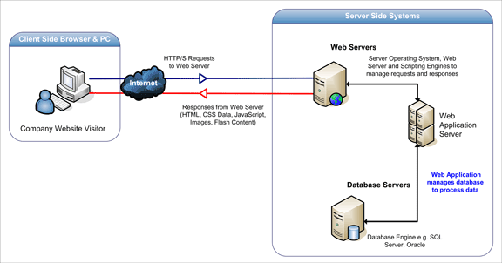
What is web application ?
Web applications are
computer programs allowing website visitors to submit and retrieve data to/from a database over the Internet using their preferred web browser.

Slide 3
Web Applications
Web applications are of the following types:
Presentation-oriented: A presentation-oriented web application generates interactive web pages containing various types of markup language (HTML, XHTML, XML, and so on) and dynamic content in response to requests.
Service-oriented: A service-oriented web application implements the endpoint of a web service. Presentation-oriented applications are often clients of service-oriented web applications.

Slide 4
Web Application Lifecycle
A web application consists of
web components;
static resource files, such as images and cascading style sheets (CSS);
and helper classes and libraries.
The web container provides many supporting services that enhance the capabilities of web components and make them easier to develop.

Slide 5
Web Application Lifecycle
However,
because a web application must take these services into account, the process for creating and running a web application is different from that of traditional stand-alone Java classes.
The process for creating, deploying, and executing a web application can be summarized as follows:
Develop the web component code.
Develop the web application deployment descriptor, if necessary.
Compile the web application components and helper classes referenced by the components.
Optionally, package the application into a deployable unit.
Deploy the application into a web container.
Access a URL that references the web application.

Slide 6
Static Websites
All are static webpages

Slide 7
Web 1.0
Dynamic Web application based on CGI

Slide 8
Web 1.0
Dynamic Web application developed with ASP.NET/JSP

Slide 9
Web 1.0
Traditional web client server interaction model

Slide 10
Web 1.0
Traditional web client server interaction model

Slide 11
Web 2.0
Ajax brought a new world in 2005

Slide 12
Web 2.0
Single Page Application

Slide 13
MVC Pattern
Applying MVC patterns to improve maintainability

Slide 14
MVC Pattern
Applying MVC patterns to improve maintainability

Slide 15
MVC & Ajax
Assemble page with retrieved data at front-end

Slide 16
MVC & Ajax
MVC at front-end

Slide 17
MVC & Ajax
MVC Pattern at front-end

Slide 18
Full-stack JavaScript & REST API
Node.js

Slide 19
Full-stack JavaScript & REST API
MongoDB - JSON

Slide 20
Web 3.0
Web3 is being touted as the future of the internet.
The vision for this new, blockchain-based web includes cryptocurrencies, NFTs, DAOs, decentralized finance, and more.
It offers a read/write/own version of the web, in which users have a financial stake in and more control over the web communities they belong to.
Web3 promises to transform the experience of being online as dramatically as PCs and smartphones did.
It is not, however, without risk.

Slide 21
HTML 5 + CSS 3

Slide 22
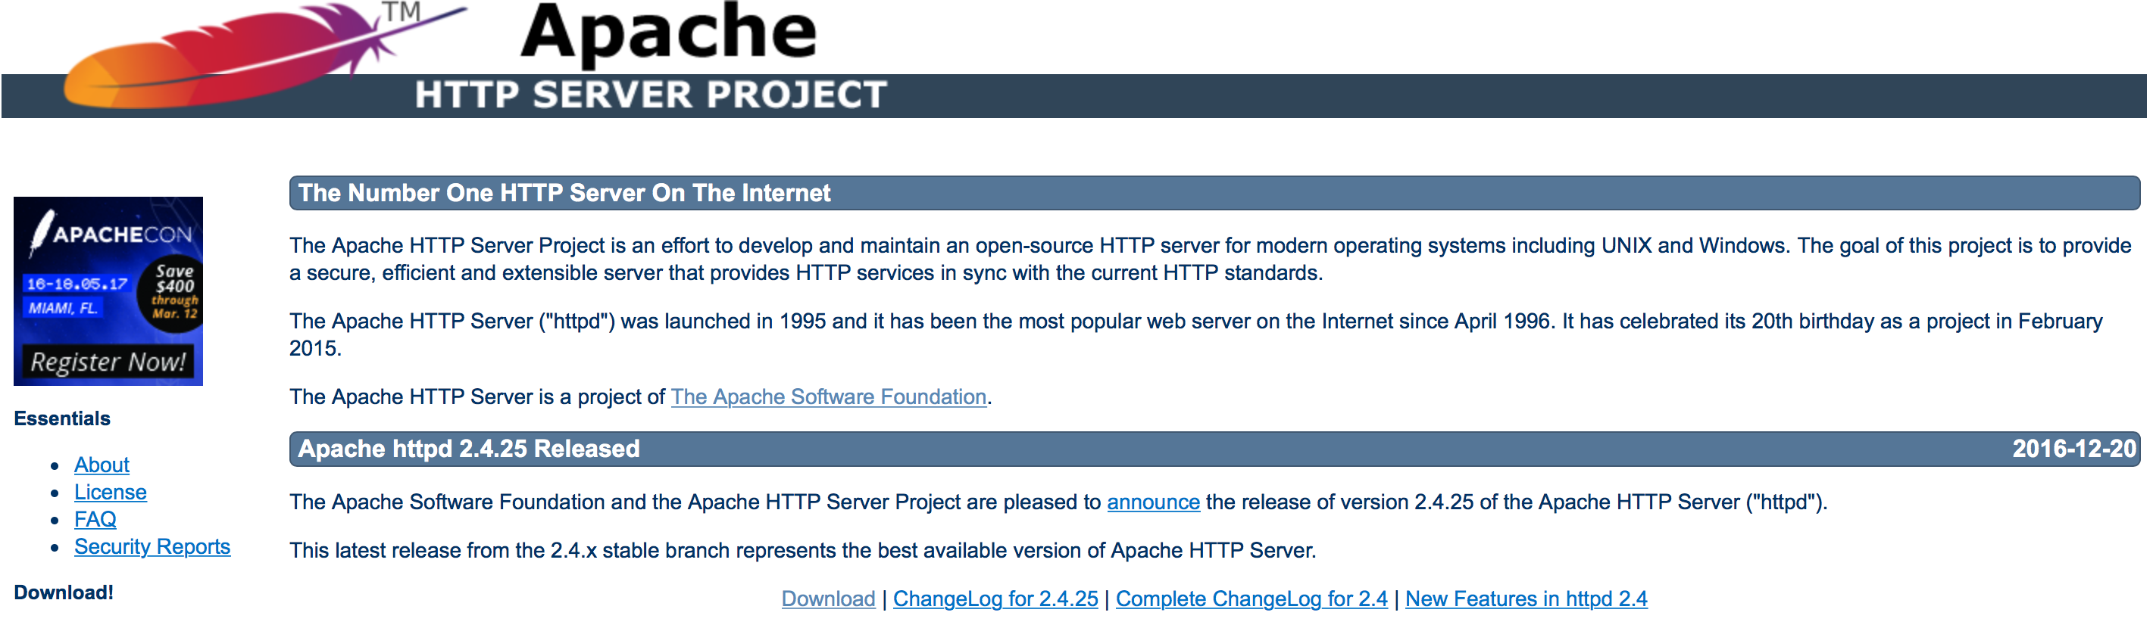
Apache HTTP Server
The Apache HTTP Server
commonly referred to as Apache (/əˈpætʃiː/ ə-PA-chee)
is a web server application notable for playing a key role in the initial growth of the World Wide Web User enters interacts with a web page.

Slide 23
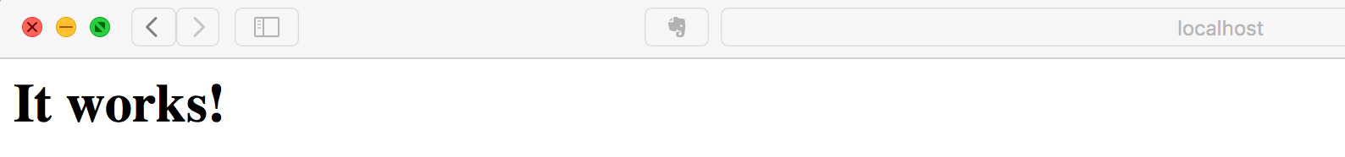
Testing
Run bin/httpd.exe (on Windows)
The Apache HTTP Server will be running in a command window.
Run sudo apachectl start (on Linux | Mac OS)
Mac OS has a built-in Apache HTTP Server.
Browse http://localhost
If the Apache HTTP Server is correctly deployed, you will see:
Shutdown sudo apachectl stop (on Linux | Mac OS)

Slide 24

PHP
PHP
Hypertext Preprocessor
PHP is a popular general-purpose scripting language that is especially suited to web development.
Fast, flexible and pragmatic, PHP powers everything from your blog to the most popular websites in the world.
From http://www.php.net/
LAMP
Linux + Apache + MySQL + PHP/Python/Perl
Facebook, Yahoo, Weibo

Slide 25

Ruby on Rails
Ruby on Rails
Rails is a web application development framework written in the Ruby language.
It is designed to make programming web applications easier by making assumptions about what every developer needs to get started.
It allows you to write less code while accomplishing more than many other languages and frameworks.
http://rubyonrails.org
If you run bin/rails routes, you'll see that it has defined routes for all the standard RESTful actions.
Github, Airbnb

Slide 26



Web Frameworks for Python
Popular Python Full-Stack Frameworks
Diango
Django is a high-level Python Web framework that encourages rapid development and clean, pragmatic design.
TurboGears 2
TurboGears 2 is built on top of the experience of several next generation web frameworks including TurboGears 1 (of course), Django, and Rails.
Web2py
Free open source full-stack framework for rapid development of fast, scalable, secure and portable database-driven web-based applications. Written and programmable in Python.
YouTube

Slide 27

Node.js
Node.js
Node.js ® is a JavaScript runtime built on Chrome's V8 JavaScript engine.
Node.js uses an event-driven, non-blocking I/O model that makes it lightweight and efficient.
Node.js' package ecosystem, npm, is the largest ecosystem of open source libraries in the world.
Emerging Technology

Slide 28
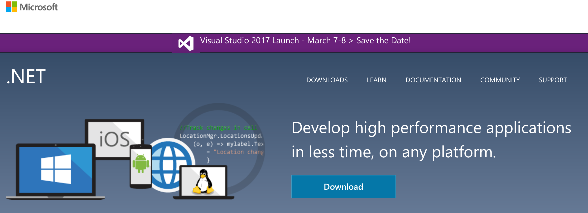
Windows .NET
Another heavy-weight framework
An alternative of Java EE
Stackoverflow

Slide 29
Windows .NET

Slide 30

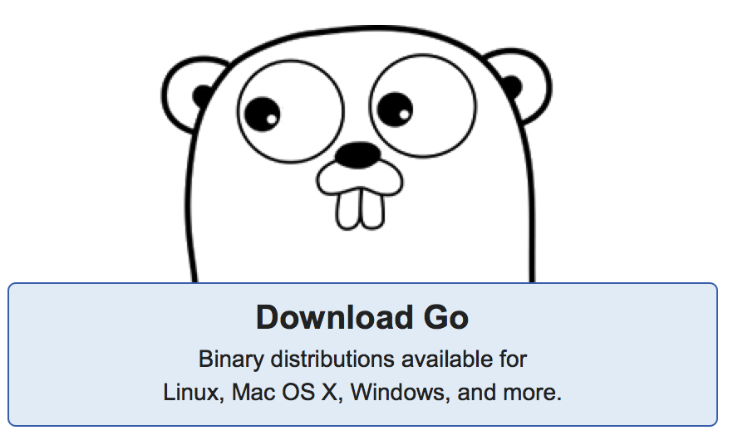
Other Options
Erlang
Erlang is a programming language used to build massively scalable soft real-time systems with requirements on high availability.
Scala
Construct elegant class hierarchies for maximum code reuse and extensibility, implement their behavior using higher-order functions. Or anything in-between.
Go
Go is an open source programming language that makes it easy to build simple, reliable, and efficient software.

Slide 31
HTTP Protocol
HTTP functions as a request–response protocol in the client–server computing model.
A web browser, for example, may be the client and an application running on a computer hosting a website may be the server.
The client submits an HTTP request message to the server.
The server, which provides resources such as HTML files and other content, or performs other functions on behalf of the client, returns a response message to the client.
The response contains completion status information about the request and may also contain requested content in its message body.
A web browser is an example of a user agent (UA).
Other types of user agent include the indexing software used by search providers (web crawlers), voice browsers, mobile apps, and other software that accesses, consumes, or displays web content.

Slide 32
HTTP Protocol
HTTP resources are identified and located on the network by Uniform Resource Locators (URLs),
using the Uniform Resource Identifiers (URI's) schemes http and https.
URIs and hyperlinks in HTML documents form inter-linked hypertext documents.
Every HTTP URL conforms to the syntax of a generic URI. A generic URI is of the form:
scheme:[//[user:password@]host[:port]][/]path[?query][#fragment]
For example:
https://en.wikipedia.org/wiki/Uniform_Resource_Locator

Slide 33
Uniform Resource Locator
scheme:[//[user:password@]host[:port]][/]path[?query][#fragment]
scheme,
consisting of a sequence of characters beginning with a letter and followed by any combination of letters, digits, plus (+), period (.), or hyphen (-).
It is followed by a colon (:).
Examples of popular schemes include http, ftp, mailto, file, data, and irc.
Two slashes (//)
This is required by some schemes and not required by some others.
An authority part, comprising:
An optional authentication section of a user name and password, separated by a colon, followed by an at symbol (@)
A "host",
consisting of either a registered name (including but not limited to a hostname), or an IP address.
An optional port number, separated from the hostname by a colon

Slide 34
Uniform Resource Locator
scheme:[//[user:password@]host[:port]][/]path[?query][#fragment]
A path,
which contains data, usually organized in hierarchical form, that appears as a sequence of segments separated by slashes.
An optional query,
separated from the preceding part by a question mark (?), containing a query string of non-hierarchical data.
Its syntax is not well defined, but by convention is most often a sequence of attribute–value pairs separated by a delimiter.
An optional fragment,
separated from the preceding part by a hash (#). The fragment contains
Query delimiter | Example
Ampersand (&) | key1=value1&key2=value2
Semicolon (;) | key1=value1;key2=value2

Slide 35
A Request & A Response
http://www.example.com/index.html
Client request
GET / HTTP/1.1
Host: www.example.com
User-Agent: Mozilla/5.0
Accept: text/html,application/xhtml+xml,application/xml;q=0.9,image/avif,image/webp,*/*;q=0.8
Accept-Language: en-GB,en;q=0.5
Accept-Encoding: gzip, deflate, br
Connection: keep-alive

Slide 36
Request Syntax
A client sends request messages to the server, which consist of:
a request line, consisting of the case-sensitive request method, a space, the requested URL, another space, the protocol version, a carriage return, and a line feed, e.g.:
GET /images/logo.png HTTP/1.1
zero or more request header fields (at least 1 or more headers in case of HTTP/1.1), each consisting of the case-insensitive field name, a colon, optional leading whitespace, the field value, an optional trailing whitespace and ending with a carriage return and a line feed, e.g.:
Host: www.example.com
Accept-Language: en
an empty line, consisting of a carriage return and a line feed;
an optional message body.
In the HTTP/1.1 protocol, all header fields except Host: hostname are optional.

Slide 37
Request Syntax
A client sends request messages to the server, which consist of:
a request line, consisting of the case-sensitive request method, a space, the requested URL, another space, the protocol version, a carriage return, and a line feed, e.g.:
GET /images/logo.png HTTP/1.1
zero or more request header fields (at least 1 or more headers in case of HTTP/1.1), each consisting of the case-insensitive field name, a colon, optional leading whitespace, the field value, an optional trailing whitespace and ending with a carriage return and a line feed, e.g.:
Host: www.example.com
Accept-Language: en
an empty line, consisting of a carriage return and a line feed;
an optional message body.
In the HTTP/1.1 protocol, all header fields except Host: hostname are optional.

Slide 38
Request methods
HTTP defines methods to indicate the desired action to be performed on the identified resource.
GET
The GET method requests a representation of the specified resource. Requests using GET should only retrieve data and should have no other effect. (idempotent)
HEAD
The HEAD method asks for a response identical to that of a GET request, but without the response body. (idempotent)
POST
The POST method requests that the server accept the entity enclosed in the request as a new subordinate of the web resource identified by the URI.
PUT
The PUT method requests that the enclosed entity be stored under the supplied URI. (idempotent)
DELETE
The DELETE method deletes the specified resource. (idempotent)

Slide 39
Request methods
HTTP defines methods to indicate the desired action to be performed on the identified resource.
TRACE
The TRACE method echoes the received request so that a client can see what (if any) changes or additions have been made by intermediate servers. (idempotent)
OPTIONS
The OPTIONS method returns the HTTP methods that the server supports for the specified URL. This can be used to check the functionality of a web server by requesting '*' instead of a specific resource. (idempotent)
CONNECT
The CONNECT method converts the request connection to a transparent TCP/IP tunnel, usually to facilitate SSL-encrypted communication (HTTPS) through an unencrypted HTTP proxy.
PATCH
The PATCH method applies partial modifications to a resource.
All general-purpose HTTP servers are required to implement at least the GET and HEAD methods, and, whenever possible, also the OPTIONS method.

Slide 40
Safe methods & Idempotent methods
Some of the methods (for example, HEAD, GET, OPTIONS and TRACE) are, by convention, defined as safe
which means they are intended only for information retrieval and should not change the state of the server.
Methods PUT and DELETE are defined to be idempotent,
meaning that multiple identical requests should have the same effect as a single request
or the response code it returns may be different on subsequent requests, the system state will be the same every time.
Methods GET, HEAD, OPTIONS and TRACE, being prescribed as safe, should also be idempotent, as HTTP is a stateless protocol

Slide 41
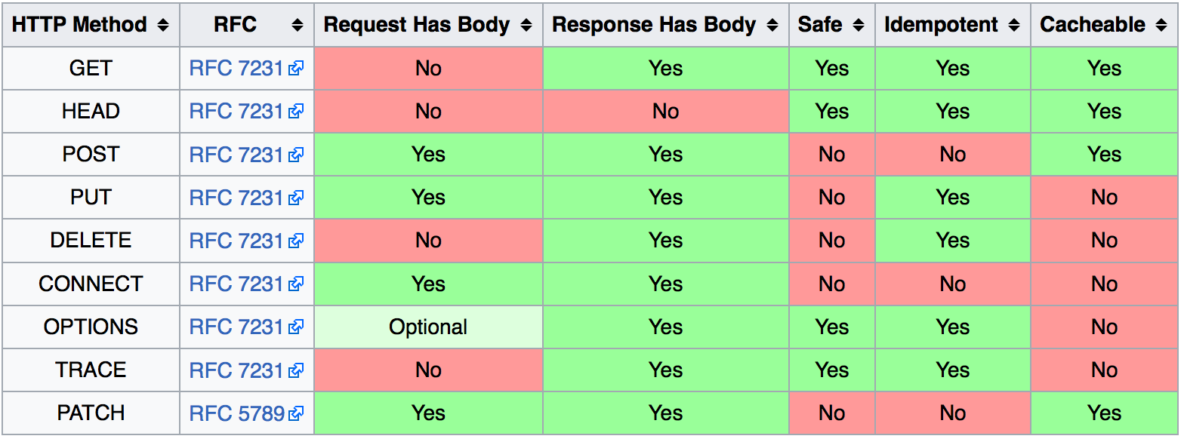
Safe methods & Idempotent methods

Slide 42
Request Header Fields
Name | Description | Example
Accept | Media type(s) that is/are acceptable for the response. See Content negotiation. | Accept: text/html
Accept-Charset | Character sets that are acceptable. | Accept-Charset: utf-8
Accept-Datetime | Acceptable version in time. | Accept-Datetime: Thu, 31 May 2007 20:35:00 GMT
Accept-Encoding | List of acceptable encodings. See HTTP compression. | Accept-Encoding: gzip, deflate
Accept-Language | List of acceptable human languages for response. See Content negotiation. | Accept-Language: en-US
Cache-Control | Used to specify directives that must be obeyed by all caching mechanisms along the request-response chain. | Cache-Control: no-cache
Connection | Control options for the current connection and list of hop-by-hop request fields.^{[14]}Must not be used with HTTP/2.^{[15]} | Connection: keep-aliveConnection: Upgrade
Content-Encoding | The type of encoding used on the data. See HTTP compression. | Content-Encoding: gzip
Content-Length | The length of the request body in octets (8-bit bytes). | Content-Length: 348
Content-Type | The Media type of the body of the request (used with POST and PUT requests). | Content-Type: application/x-www-form-urlencoded
Cookie | An HTTP cookie previously sent by the server with Set-Cookie (below). | Cookie: $Version=1; Skin=new;

Slide 43
A Request & A Response
http://www.example.com/index.html
Server response
HTTP/1.1 200 OK
Date: Mon, 23 May 2005 22:38:34 GMT
Content-Type: text/html; charset=UTF-8
Content-Length: 155
Last-Modified: Wed, 08 Jan 2003 23:11:55 GMT
Server: Apache/1.3.3.7 (Unix) (Red-Hat/Linux)
ETag: "3f80f-1b6-3e1cb03b"
Accept-Ranges: bytes
Connection: close
<html>
<head>
<title>An Example Page</title>
</head>
<body>
<p>
Hello World, this is a very simple HTML document.
</p>
</body>
</html>

Slide 44
Response Syntax
A server sends response messages to the client, which consist of:^{[47]}
a status line, consisting of the protocol version, a space, the response status code, another space, a possibly empty reason phrase, a carriage return and a line feed, e.g.:
HTTP/1.1 200 OK
zero or more response header fields, each consisting of the case-insensitive field name, a colon, optional leading whitespace, the field value, an optional trailing whitespace and ending with a carriage return and a line feed, e.g.:
Content-Type: text/html
an empty line, consisting of a carriage return and a line feed;
an optional message body.

Slide 45
Response Status
In HTTP/1.0 and since,
the first line of the HTTP response is called the status line and includes a numeric status code (such as "404") and a textual reason phrase (such as "Not Found").
The first digit of the status code defines its class:
1XX (informational) The request was received, continuing process.
2XX (successful) The request was successfully received, understood, and accepted.
3XX (redirection) Further action needs to be taken in order to complete the request.
4XX (client error) The request contains bad syntax or cannot be fulfilled.
5XX (server error) The server failed to fulfill an apparently valid request.

Slide 46
Response Header Fields
Field name | Description | Example
Accept-CH | Requests HTTP Client Hints | Accept-CH: UA, Platform
Access-Control-Allow-Origin, Access-Control-Allow-Credentials, Access-Control-Expose-Headers, Access-Control-Max-Age, Access-Control-Allow-Methods, Access-Control-Allow-Headers^{[13]} | Specifying which web sites can participate in cross-origin resource sharing | Access-Control-Allow-Origin: *
Age | The age the object has been in a proxy cache in seconds | Age: 12
Allow | Valid methods for a specified resource. To be used for a 405 Method not allowed | Allow: GET, HEAD
Content-Encoding | The type of encoding used on the data. See HTTP compression. | Content-Encoding: gzip
Content-Language | The natural language or languages of the intended audience for the enclosed content^{[51]} | Content-Language: da
Content-Length | The length of the response body in octets (8-bit bytes) | Content-Length: 348
Content-Location | An alternate location for the returned data | Content-Location: /index.htm
Content-Type | The MIME type of this content | Content-Type: text/html; charset=utf-8

Slide 47

HTTP session
An HTTP session is a sequence of network request-response transactions.
TCP 3-Way Handshake
from: http://blog.csdn.net/wangshihui512/article/details/9051819
EVENT | DIAGRAM
Host A sends a TCP SYNchronize packet to Host B Host B receives A's SYN Host B sends a SYNchronize-ACKnowledgement Host A receives B's SYN-ACK Host A sends ACKnowledge Host B receives ACK. TCP socket connection is ESTABLISHED. | TCP Three Way Handshake (SYN, SYN-ACK, ACK)

Slide 48
HTTP session state
HTTP is a stateless protocol
A stateless protocol does not require the HTTP server to retain information or status about each user for the duration of multiple requests.
from: https://www.openhome.cc/Gossip/ServletJSP/BehindHttpSession.html

Slide 49
HTTP session state
HTTP is a stateless protocol
A stateless protocol does not require the HTTP server to retain information or status about each user for the duration of multiple requests.
from: https://www.openhome.cc/Gossip/ServletJSP/BehindHttpSession.html

Slide 50
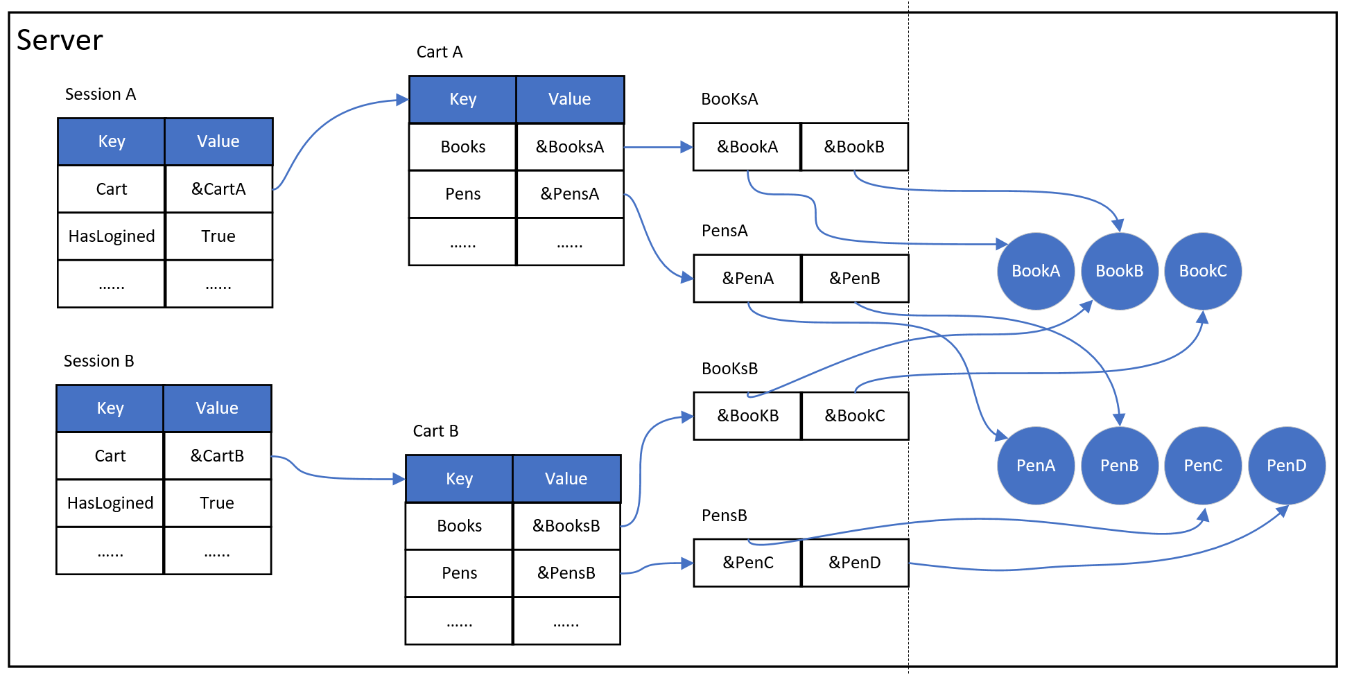
HTTP session state
HTTP is a stateless protocol

Slide 51
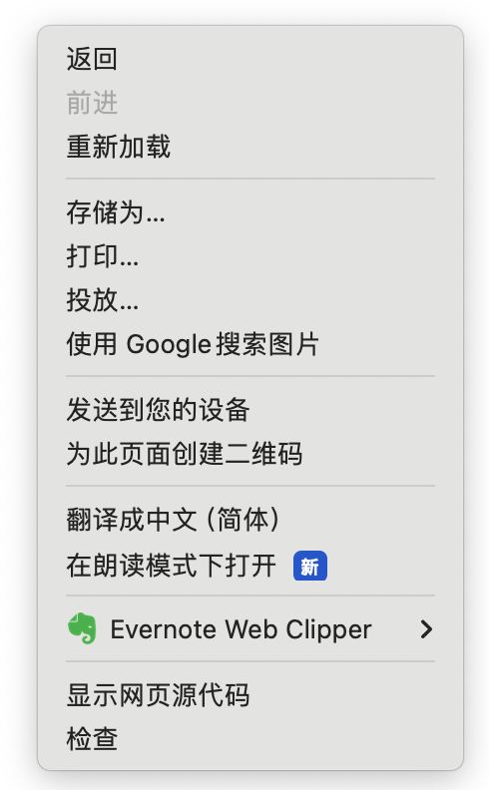
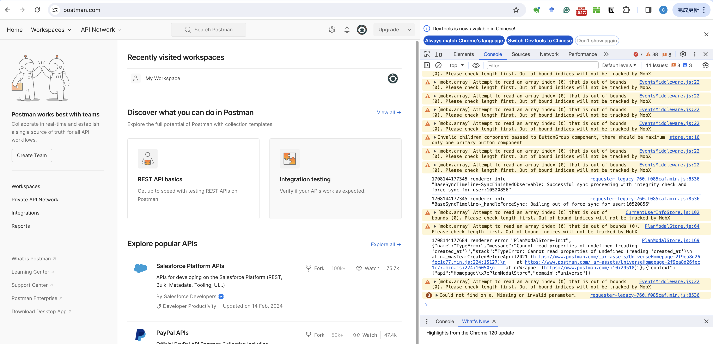
Chrome Debugging

Slide 52

Postman
Postman is an API platform for building and using APIs.
Postman simplifies each step of the API lifecycle and streamlines collaboration so you can create better APIs—faster.
Dowload
https://www.postman.com/
Docs
https://learning.postman.com/docs/introduction/overview/

Slide 53
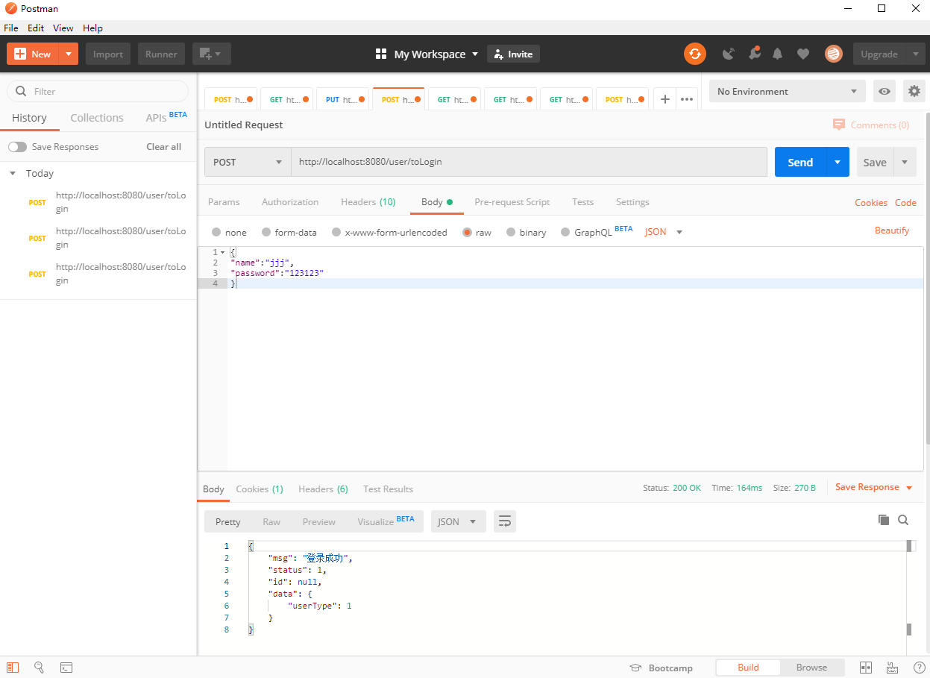
Postman
RequestMethod
URL
点击发送
Cookies
Request Headers
Request Body
Response Body

Slide 54
References
Web开发的发展史
https://linux.cn/article-3166-1.html
JAVE SOFTWARE SOLUTIONS: FOUNDATIONS OF PROGRAM DESIGN (Eighth Edition)
JOHN LEWIS(Virginia Tech), WILLIAM LOFTUS (Accenture)
The Java EE 8 Tutorial – Web Applicaitons
https://javaee.github.io/tutorial/webapp001.html
Web 3.0
https://en.wikipedia.org/wiki/Web3
What is Web 3..0
https://hbr.org/2022/05/what-is-web3

Slide 55
References
Django
https://www.djangoproject.com
Turbogears
http://www.turbogears.org
Web2py
http://www.web2py.com/init/default/documentation
Node.js
https://nodejs.org/
Windows .NET
http://www.microsoft.com/net
Erlang
http://www.erlang.org
Scala
http://www.scala-lang.org
Go
https://golang.org

Slide 56
References
Hypertext Transfer Protocol
https://en.wikipedia.org/wiki/Hypertext_Transfer_Protocol
Uniform Resource Locator
https://en.wikipedia.org/wiki/Uniform_Resource_Locator
List of HTTP header fields
https://en.wikipedia.org/wiki/List_of_HTTP_header_fields#Request_fields
HttpSession 原理
https://www.openhome.cc/Gossip/ServletJSP/BehindHttpSession.html

Slide 57

Web开发技术
Web Application Development
Thank You!

